Slide 1
Analysis of Child Care Cost Data
Ryan Frank
DSC640 Term Project

Slide 2
Medium 1:
Interactive Tableau Dashboard

Slide 3
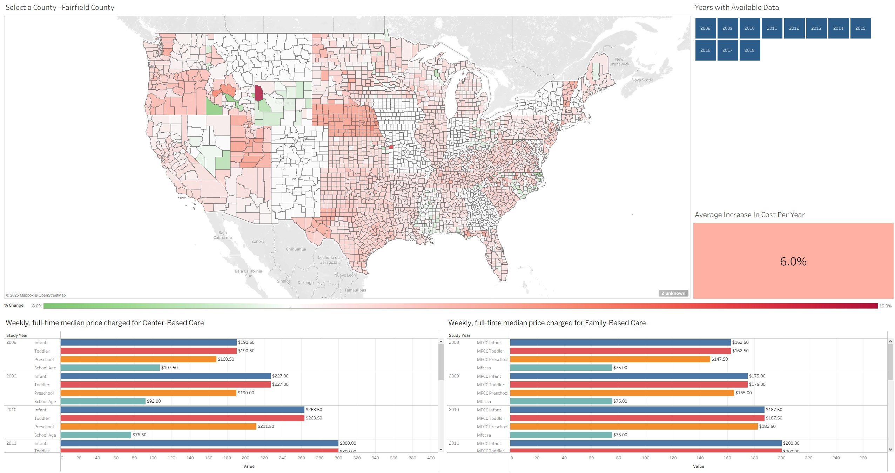
Initial View

Slide 4
Overview
The top right contains a clickable map of the United States at the county level. Counties are colored by the average percent that childcare (of all types and age groups) changed over the time frame of available data
Counties in white likely on had a single year of data, or incomplete data which made the calculation impossible
Clicking on a county updates the rest of the visualizations with the data for that county
The top right visualization represents the years the data we have covered (2008 – 2018) and colored to indicate if the selected county has data for that year (Blue for yes, Red for No)
The middle right is a color-coded box that shows the average yearly change in childcare cost for the selected county.
Below the map shows the color scale for the map based on the average yearly change in childcare cost
Finally, the bottom visualization are sets of bar graphs that show the actual cost of childcare, broken down by type of care (Center or Family based), age group, and year.

Slide 5
Points of Interest
While the overall stats in the data showed an increasing trend across the country, there are areas that actually saw a decrease in cost over time.
There were also areas that show a much higher increase per year vs the rest of the country. The initial view starts focusing on my home county of Fairfield CT which has a rather large 6% average increase per year from 2008-2018
Following slides show images when selecting some of the other unusual counties – in particular a county in Wyoming that saw a nearly 19% yearly increase in costs for 2014-2018, and a county in Idaho that had a nearly 7% decrease in cost per year from 2012-2018
These would be a good starting point at investigating local conditions that lead to these results

Slide 6
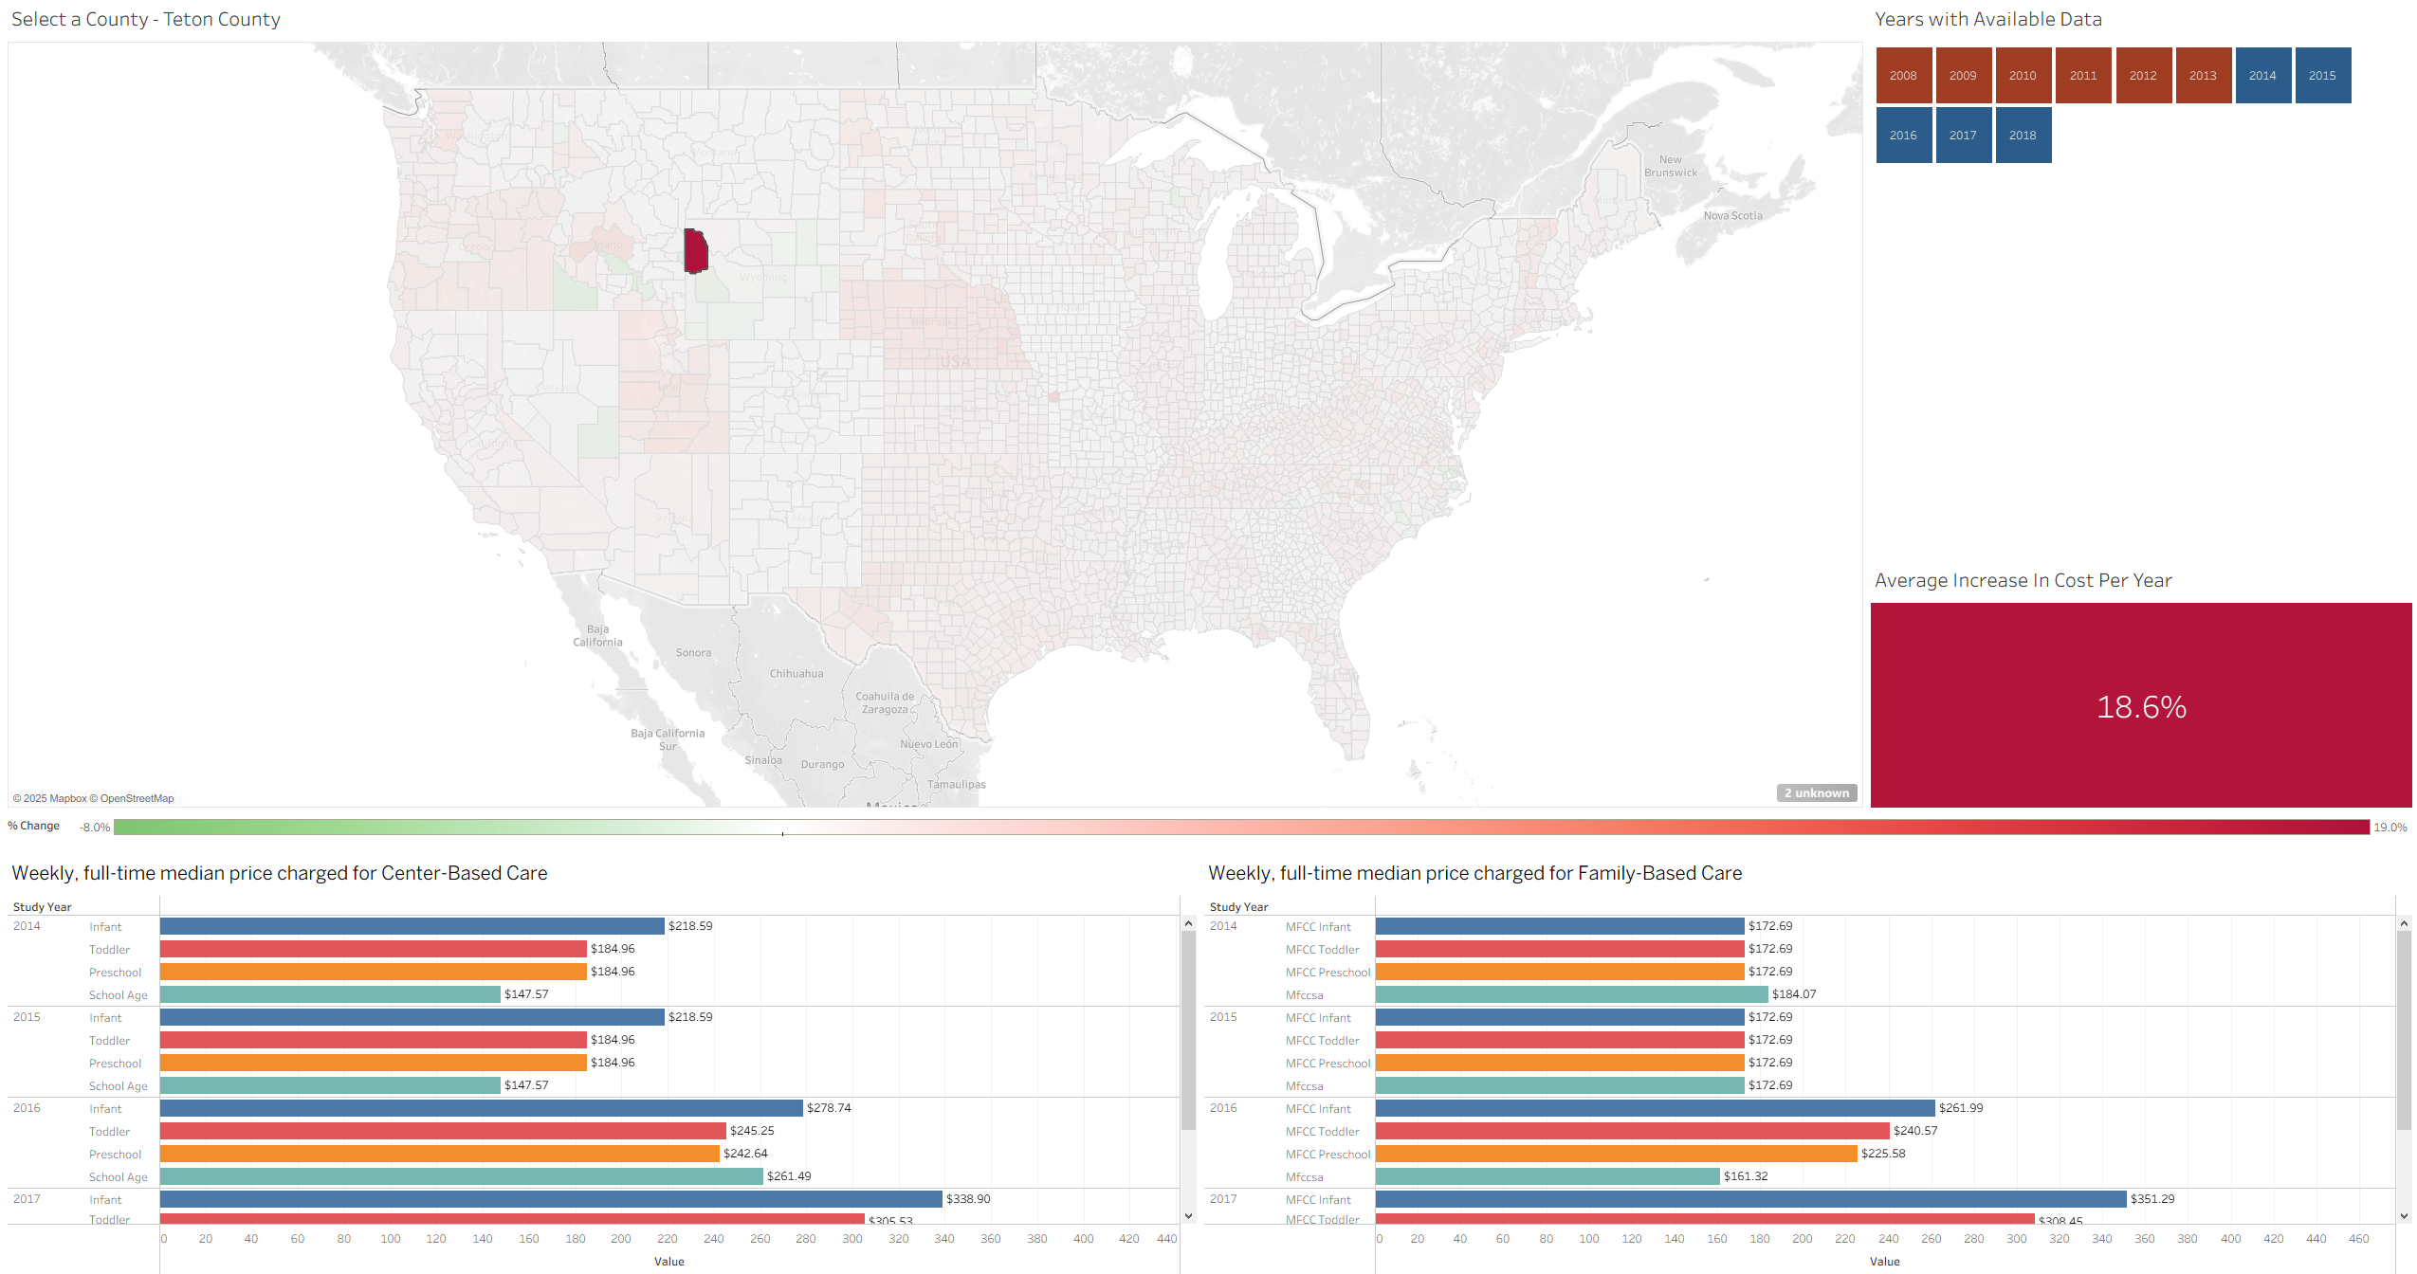
Teton County, WY

Slide 7
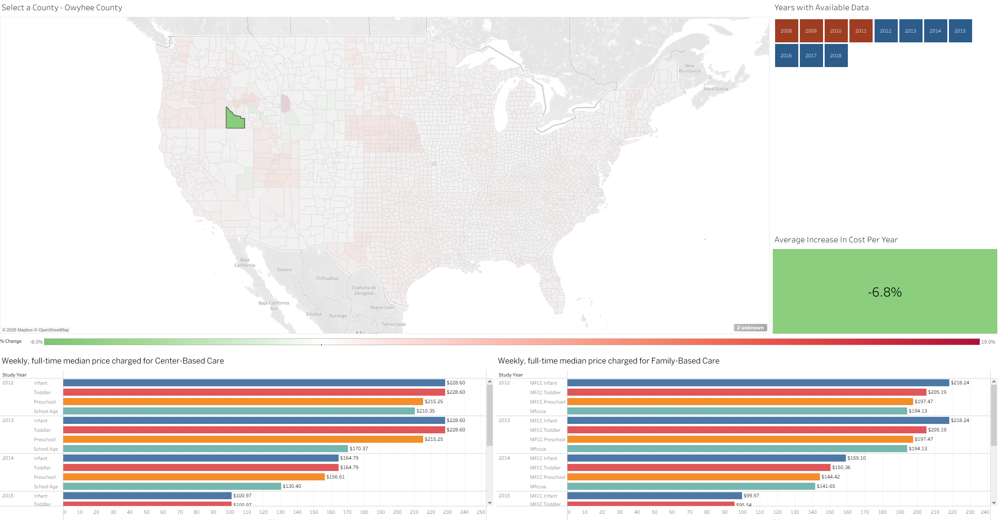
Owyhee County, ID

Slide 8
Medium 2:
Power Point Deck

Slide 9
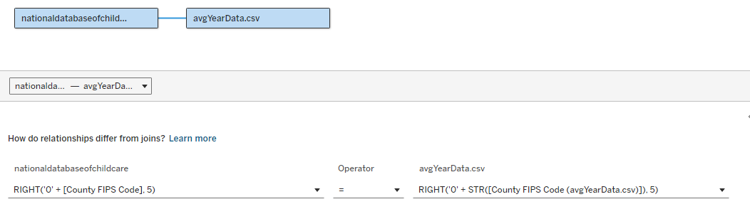
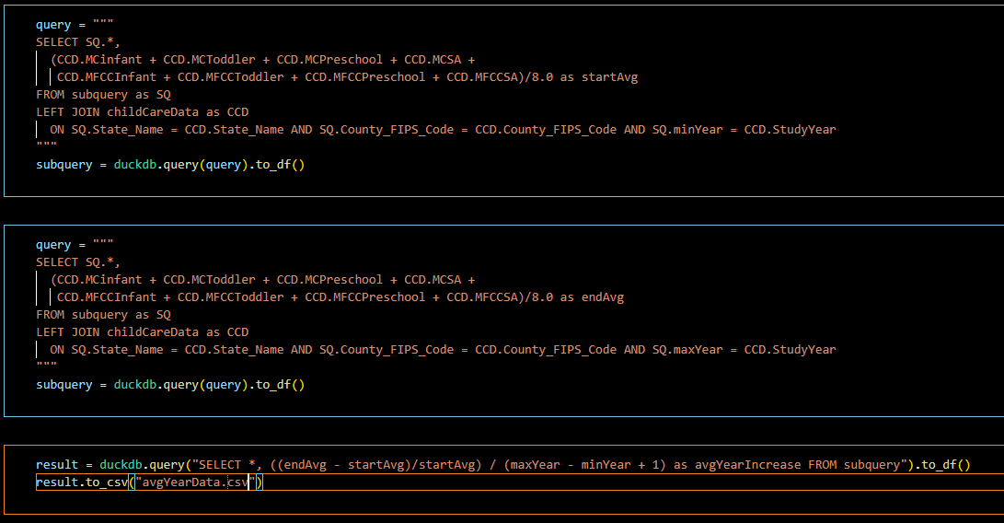
Data Cleaning and Organization
Dashboard
  I used a combination of the original dataset connected to Tableau and a dataset I created using Python and then exported back to a text file that Tableau could connect to
  The avgYearData.csv is the file I produced in python, using the libraries pandas and duckdb which allows for SQL like queries to be executed against pandas data frames

Slide 10
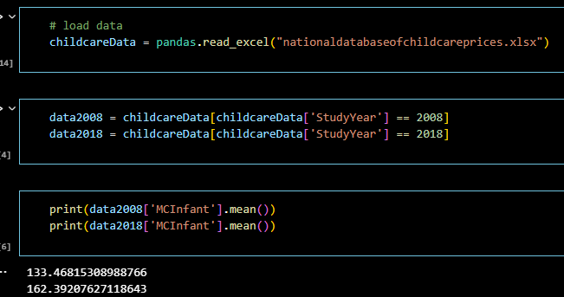
Data Cleaning and Organization (cont.)
Infographic
  Data for the infographic was focused more on national trends, and we produced by loading the provided dataset into a pandas data frame and getting national averages on year slices

Slide 11
Audience
Dashboard
  Targeting individuals who want to see local cost for childcare
  Could also be used to find unusual data for further investigation
Infographic
  National trends, provide information on overall trends in the US and push towards getting local information and try to improve trends
Power Point
  This slide desk is meant to be an explanation of how the data was explored and would be of interest to anyone is a similar field or was interesting in how the visualizations were produced

Slide 12
Results
Infographic
  High level finds show that care costs increased between 20 – 26 % of the 10 year period (or an average of 2 – 2.6% per year) depending on type and age group.
  Median Household income only increased by 18% (or 1.8% per year) in the same period.
  Any type of care outpaced the median income increases
Dashboard
  National Trends are also seen here, although more granular data view is provided. There are actually places where costs went down, so there may be something worth looking into to see if it can be emulated elsewhere
  There are also example of extremely high increases in cost, and should also be examined as a possible negative example

Slide 13
Medium 3:
Infographic

Slide 14


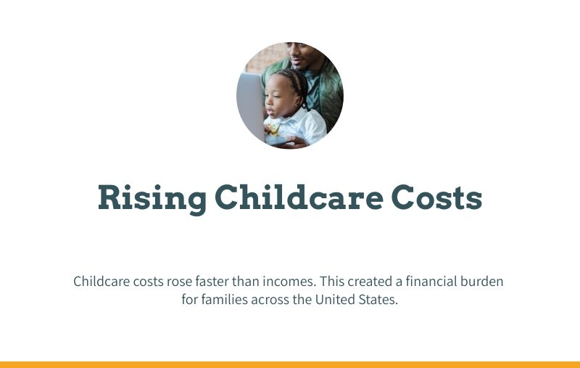
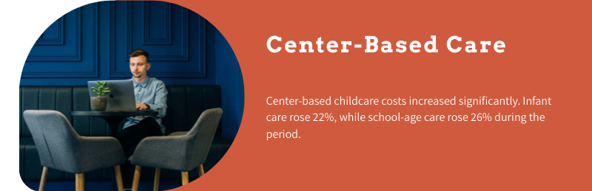
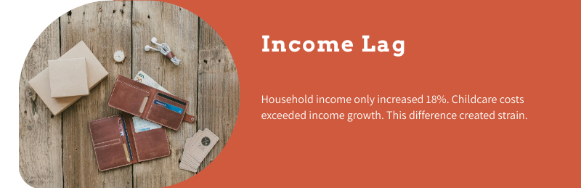
Infographic

Slide 15
Other Files Included
Frank640 - Project Dashboard.twb
  Workbook containing Interactive Dashboard
Frank640 Project Infographic Data.ipynb
Frank640 - Project Data Source.ipynb
  Notebook code used in data processing
Frank640 - Project Final Paper.docx
  Final paper

